Slide 1


Social Buzz Analysis

Slide 2


Outline for Today
Project overview
Problem Statement
The Analytics team
Process
Insights
Summary
Recommendations

Slide 3

Social Buzz, a rapidly expanding technology unicorn, is poised for global scalability. To navigate this growth, Accenture has initiated a strategic 3-month Proof of Concept (POC) with a focus on three key areas:
Conducting a comprehensive audit of Social Buzz's big data practices.
Providing strategic recommendations to ensure a successful IPO.
Analysis of Social Buzz's vast content landscape to identify the top 5 most popular categories
Project Overview

Slide 4


Problem
With over 100,000 daily posts and a staggering 36.5 million pieces of content annually, Social Buzz faces the challenge of capitalizing on this immense volume. The pivotal question emerges:
How can the company effectively harness and monetize this abundance?
Analysis to identify Social Buzz's top 5 most popular content categories.

Slide 5



Tolulope Okerayi
Data Analyst
The Analytics Team
Marcus Rompton
Senior Principal
Andrew Fleming
Chief Technical Architect

Slide 6
Process
1
Data Understanding
Data Cleaning
2
Data Modelling
3
Data Analysis
4
Insights
5

Slide 7

Insights
16
Animals
Monday (3581)
Top Content Category by Popularity Score
Highest Weekly Post Volume
Unique Categories

Slide 8
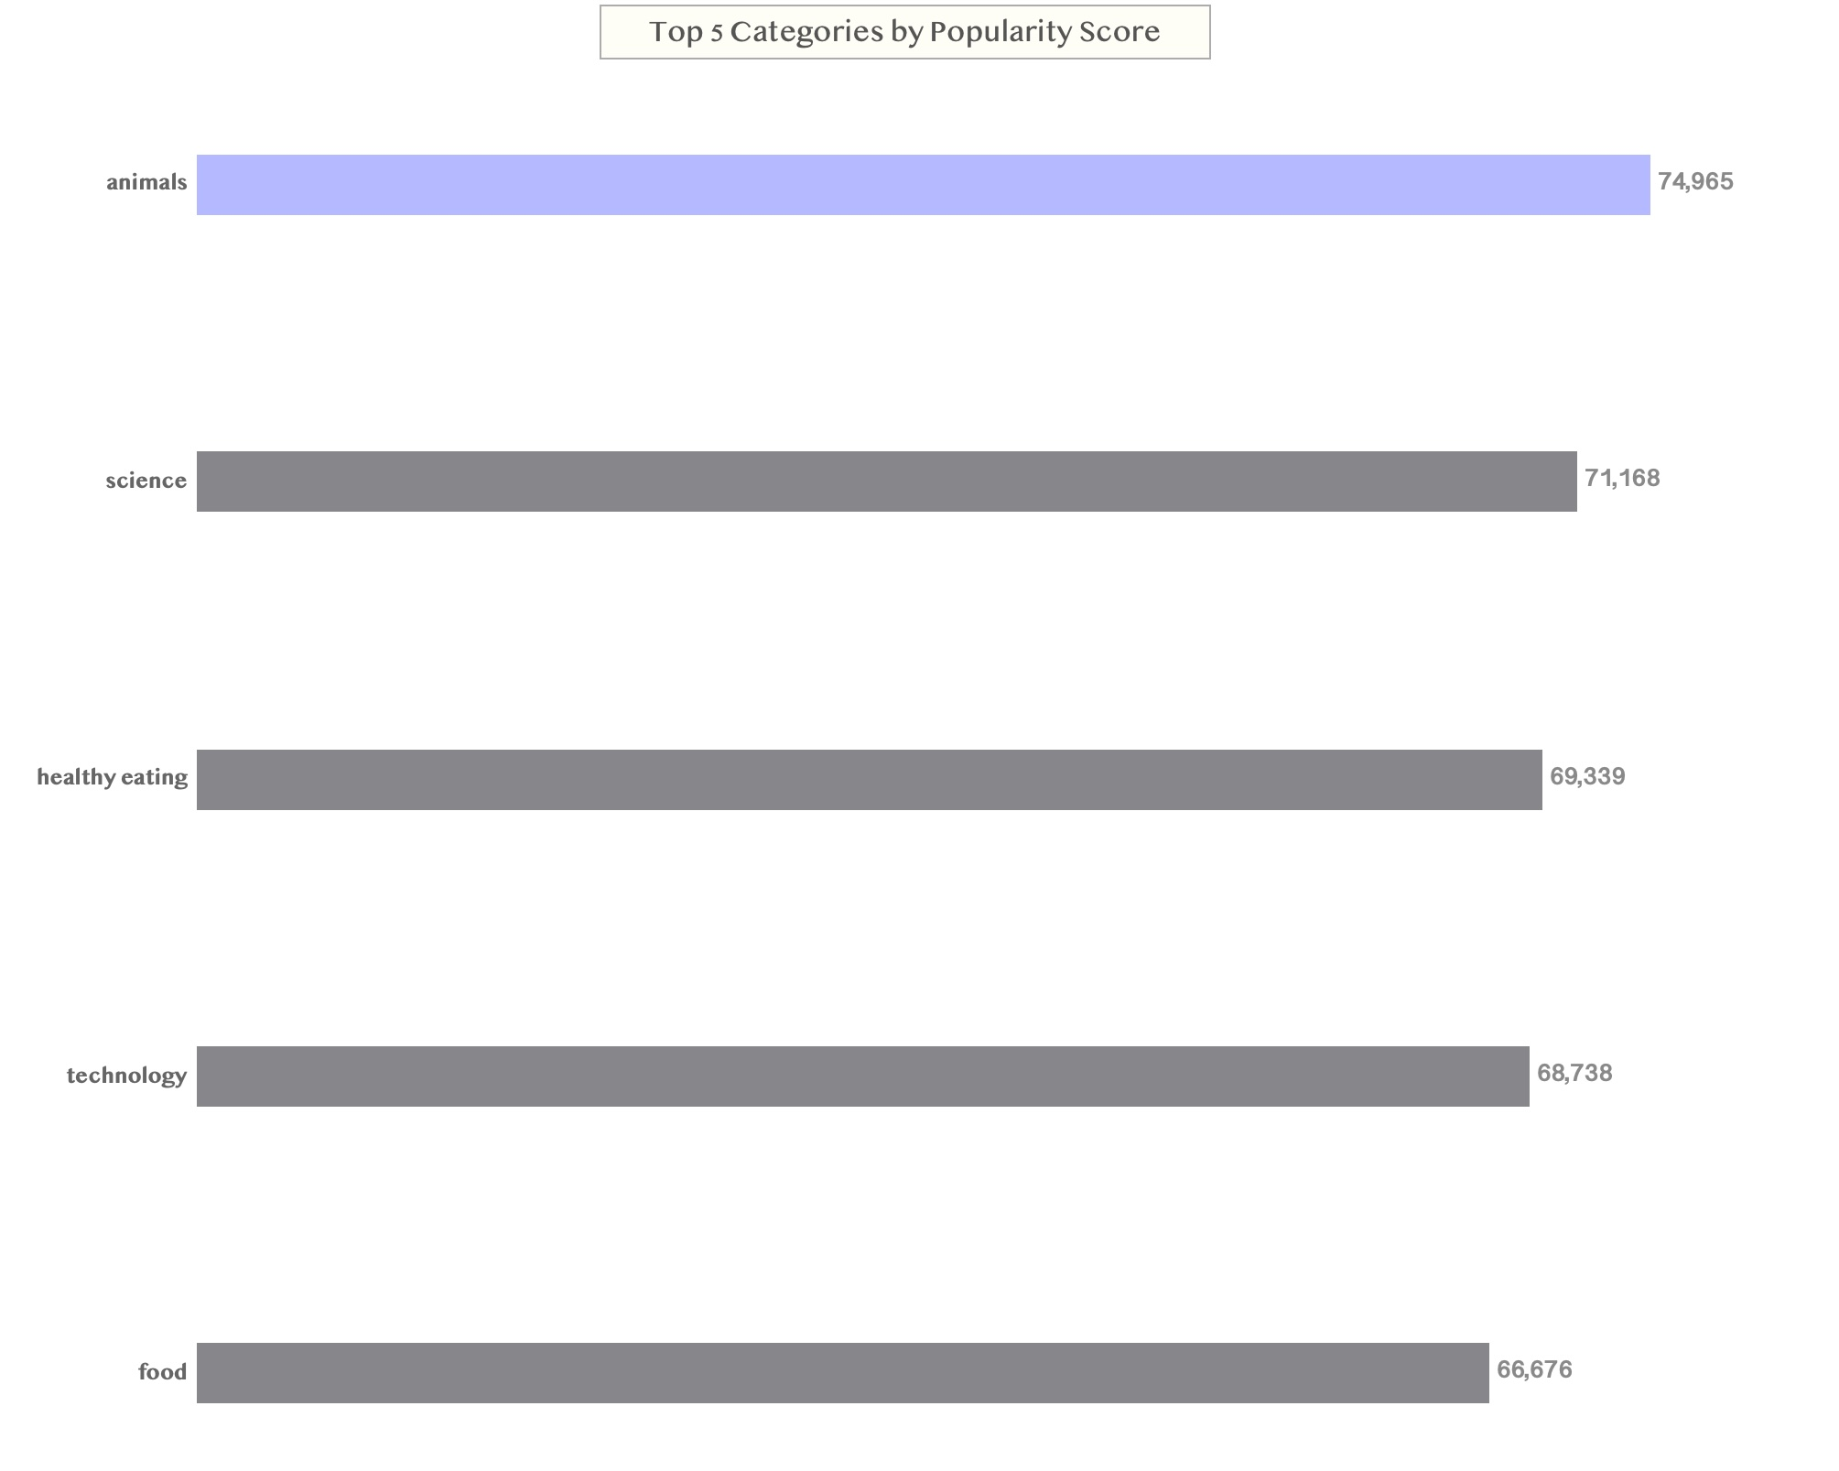

Slide 9
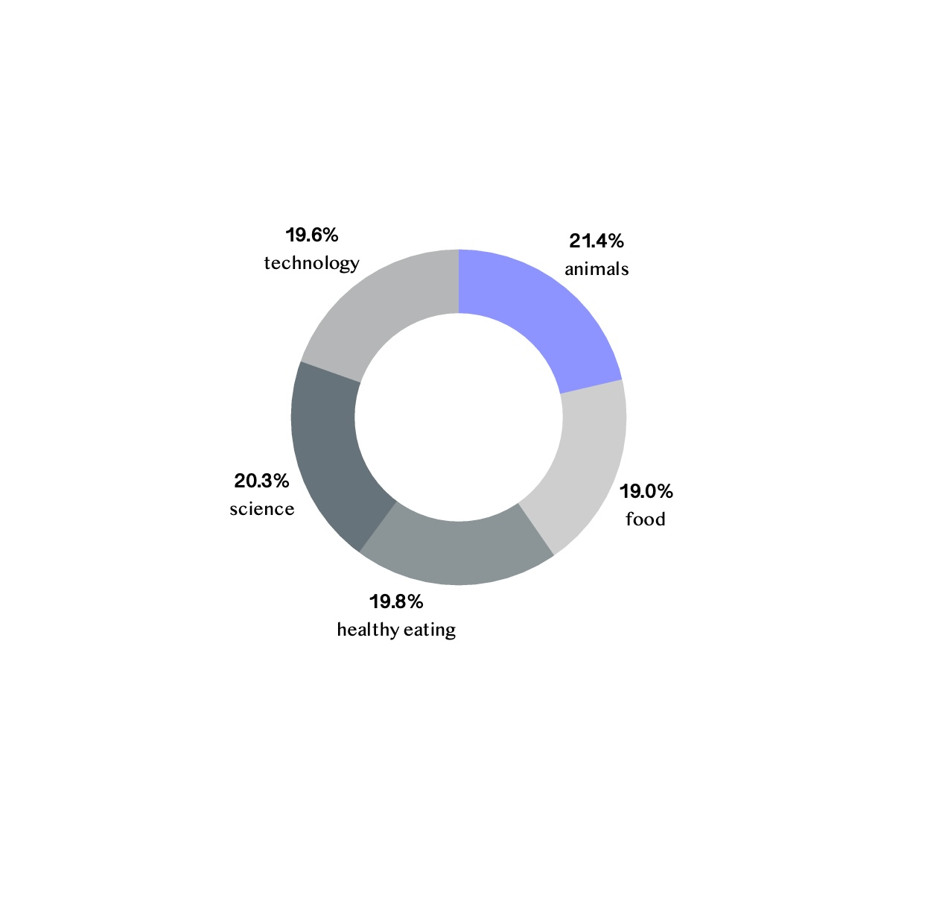

Slide 10
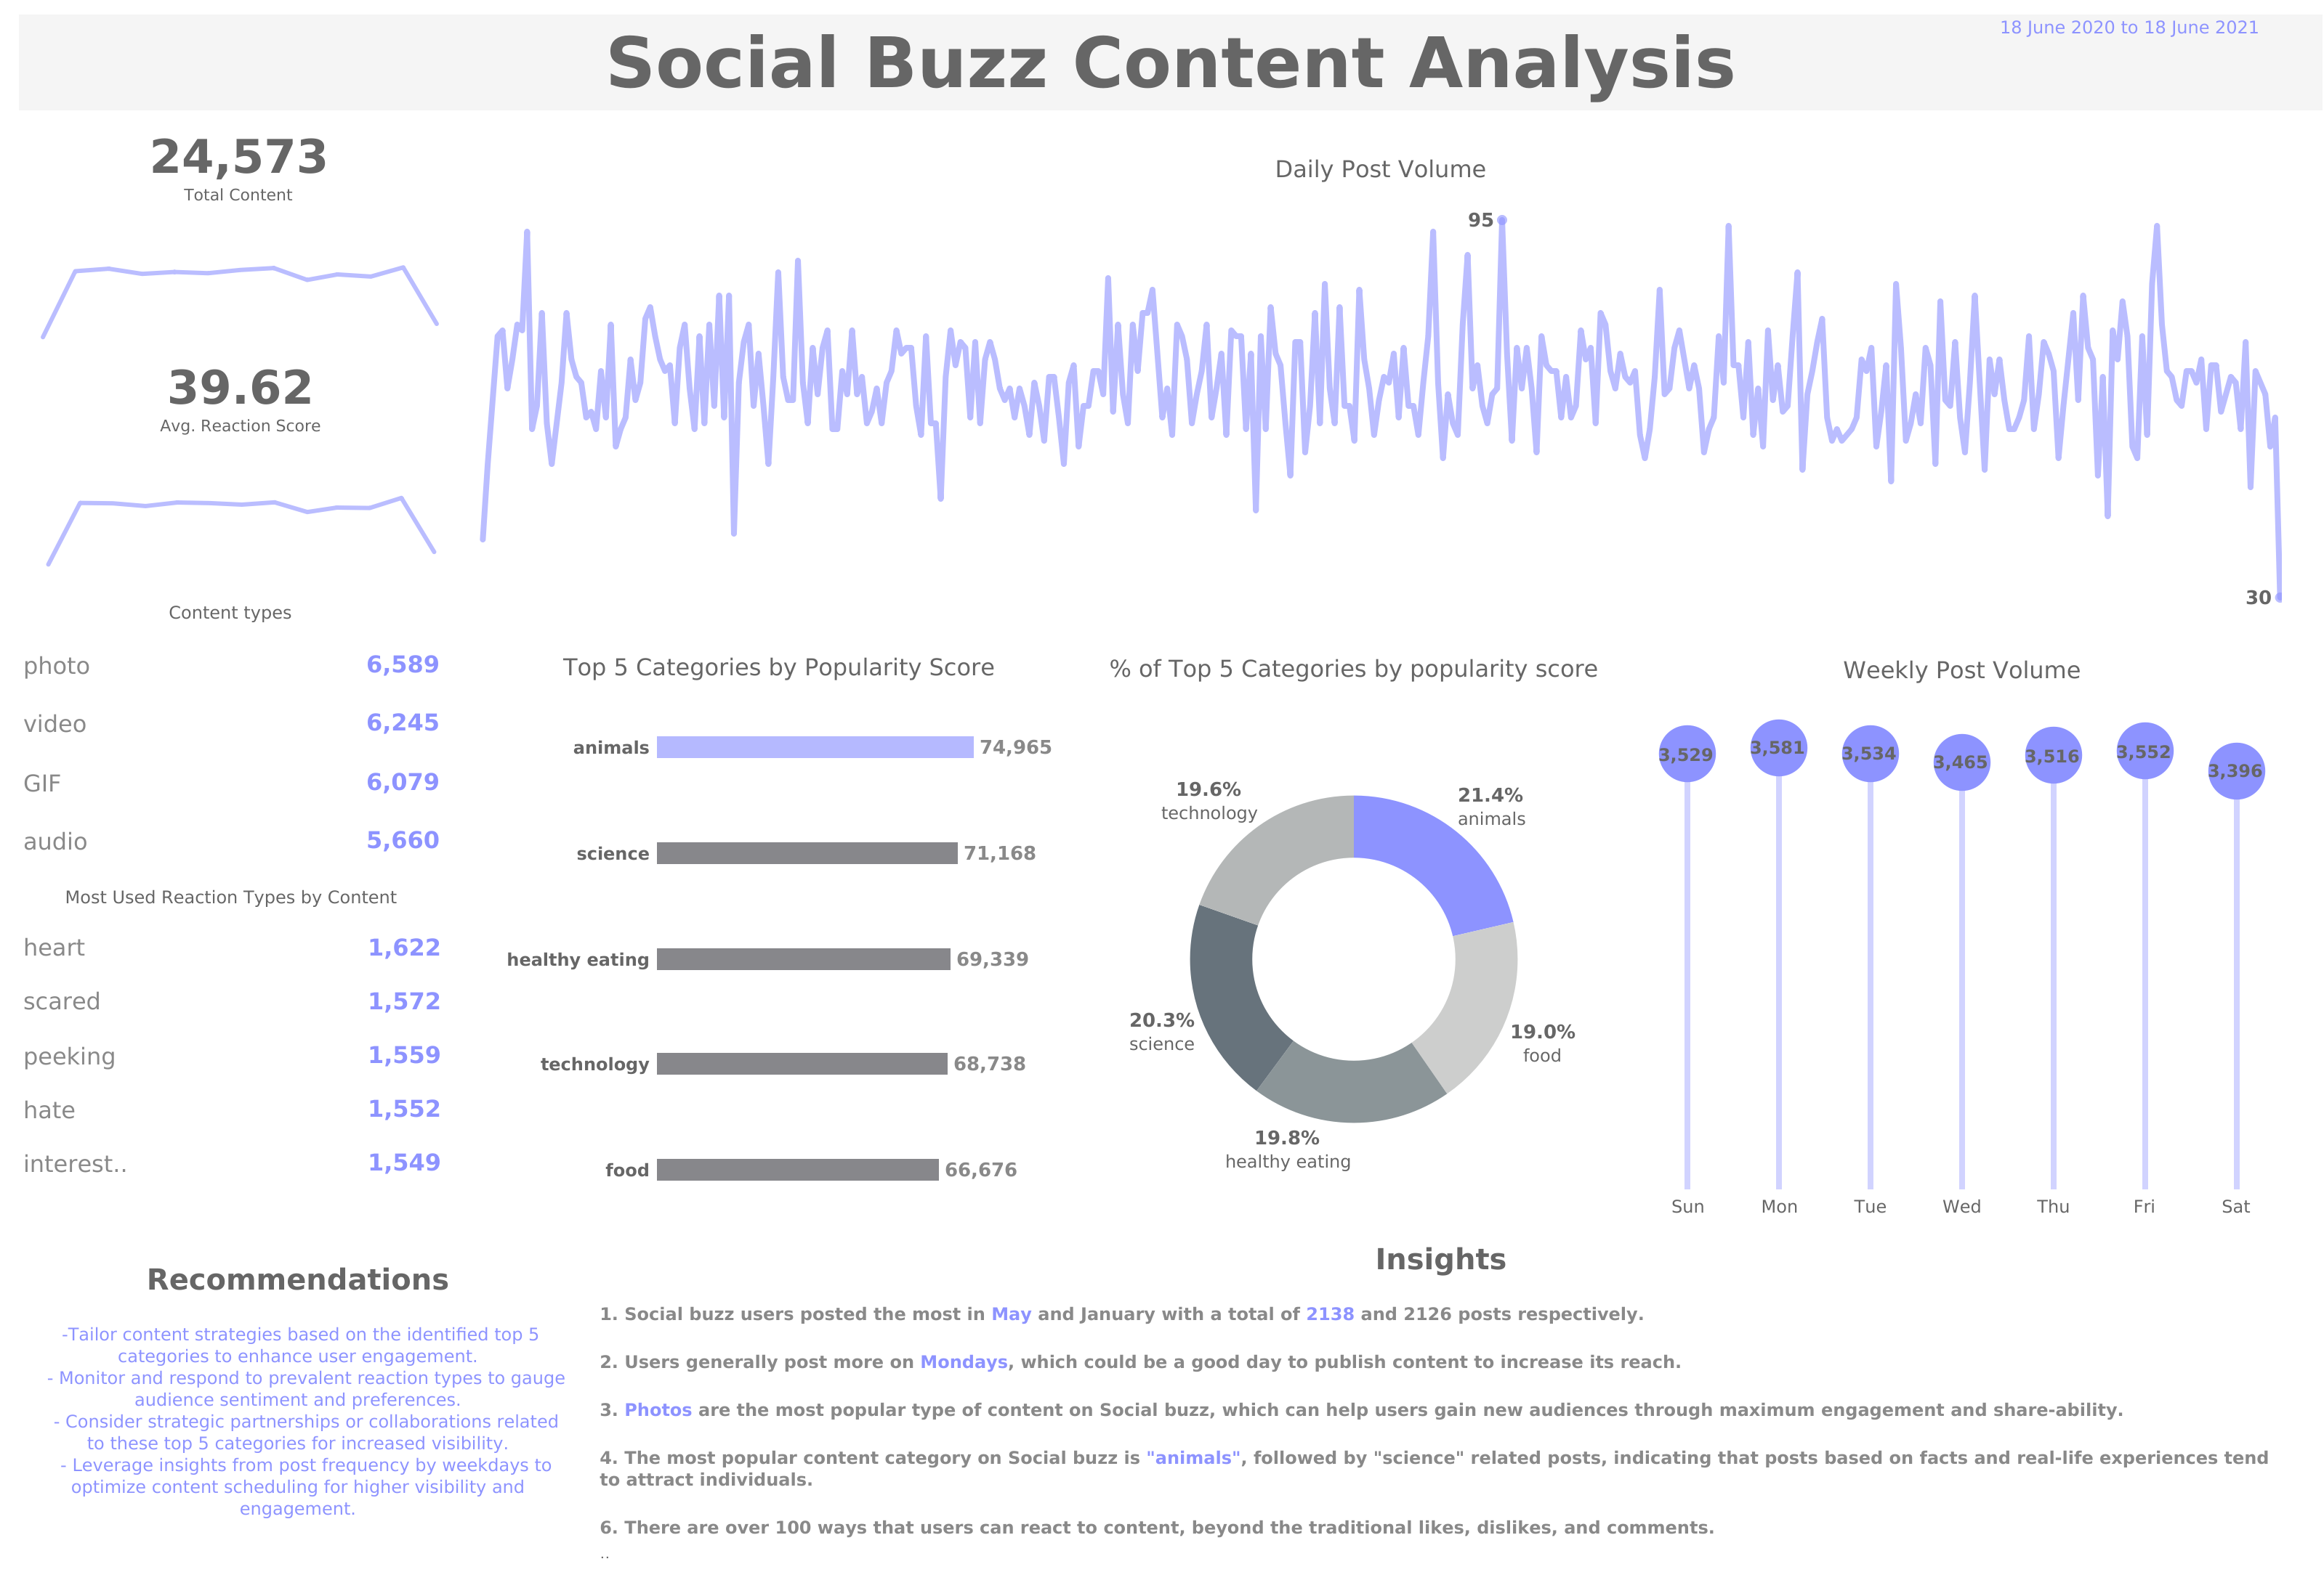

Slide 11

Insights
﻿﻿Social buzz users posted the most in May and January with a total of 2138 and 2126 posts respectively.
﻿Users generally post more on Mondays, which could be a good day to publish content to increase its reach.
﻿The most popular content category on Social buzz is "animals" followed by "science" related posts, indicating that posts based on facts and real-life experiences tend to attract individuals.
﻿There are over 100 ways that users can react to content, beyond the traditional likes, dislikes, and comments.
﻿The most commonly used reaction type is ”heart " indicating that posts that trigger an emotional response tend to generate more reactions
Summary

Slide 12
Recommendations
Tailor content strategies based on the identified top 5 categories to enhance user engagement.
Monitor and respond to prevalent reaction types to gauge audience sentiment and preferences.
Consider strategic partnerships or collaborations related to these top 5 categories for increased visibility.
Leverage insights from post frequency by weekdays to optimize content scheduling for higher visibility and engagement.
Summary
Interact with the Social Buzz Content Analysis dashboard

Slide 13

Thank you!
ANY QUESTIONS?

